Slide 1
BrAPI 101
A Beginners Guide

Slide 2
What is BrAPI?
BrAPI is a …
Standardized
RESTful
Web Service
API
Specification
…for communicating plant breeding data

Slide 3


API – Application Programing Interface
User Interface
GUI
CMD
Hardware
Application Programing Interface
Web Service
Local Messaging Service
Job Queue
Language Library

Slide 4
Web Service
Service Consumer
Request
Response
Sends
2 and 3
Gets
5
A Service Provider contains some Service with well defined Inputs and Outputs
A Service Consumer sends a request to the Service Provider with the Input data, and waits for a response
The Service performs some Function on the Input data
The Service Provider sends the Output data as a Response back to the Service Consumer
Network
Service Provider
Service
X
Function
X + Y = Z
Z
Y
Inputs
Output

Slide 5
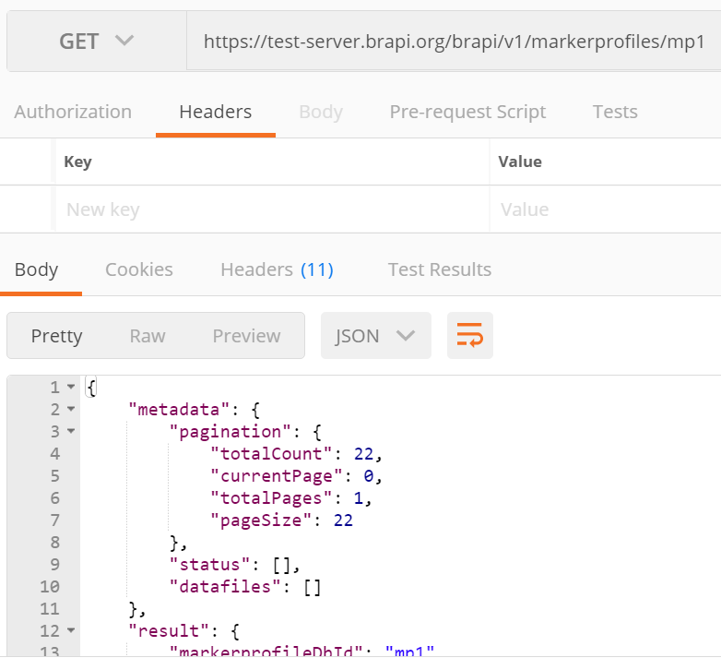
REST - Representational State Transfer
REST is an architecture design for creating Web Services using the well-known HTTP standard
Requests are made with URLs
Data is represented with JSON

Slide 6
Standardized Specification
BrAPI has defined a Standardized set of data model structures to communicate the basic information of plant breeding
BrAPI is a technical Specification which software developers can easily turn into code which communicates using the Standard.

Slide 7
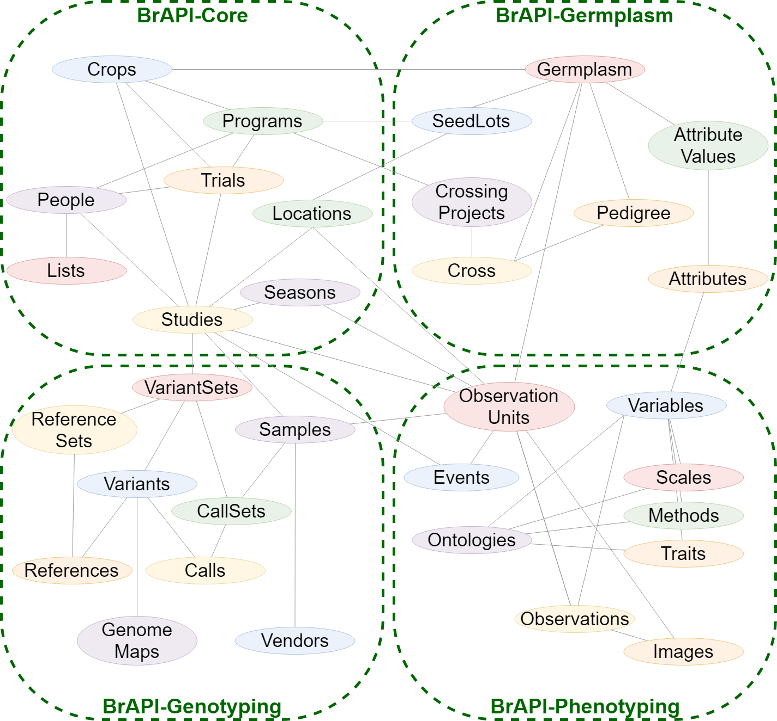
BrAPI Domains
The BrAPI Data Model defines the data and metadata required for any generic breeding trials. The data models are designed to be easily interpreted by a computer in any programing language.

Slide 8
Why do we need BrAPI?

Slide 9
Integration and Interoperability
Important For Humans
Semantic interoperability concerns the definitions of words and data.
Example: “plant height” may mean the distance from the tallest leaf to the ground or to the lowest root.
Syntactic interoperability concerns the structure of data and how it is organized.
Example: the taxa information might be organized “genus species sub-taxa” or “sub-taxa species genus” in different systems, even though they contain the same information.
Protocol interoperability concerns the mechanism for how data transfers from one place to another.
Example: one system only provides file downloads and another system only provides an API. These two systems could use the same semantics and syntax, but are still not easily interoperable.
Important For Software
Notes:
Interoperability is a measure of how easy it is for two or more systems to interact and share data. Interoperability should be judged in three ways; semantics, syntax, and protocol.

Slide 10
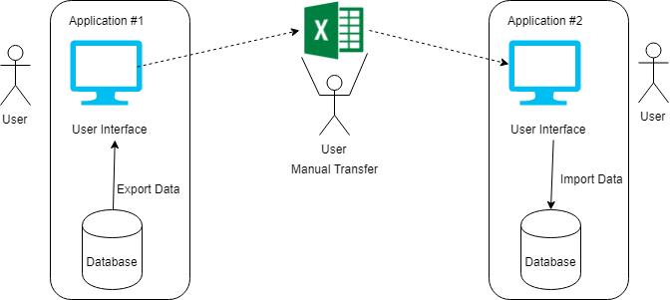
Manual Data Transfer

Slide 11
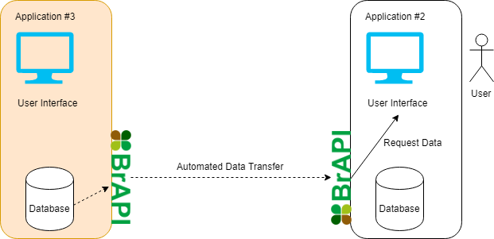
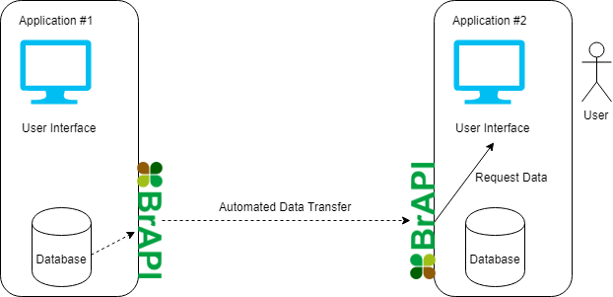
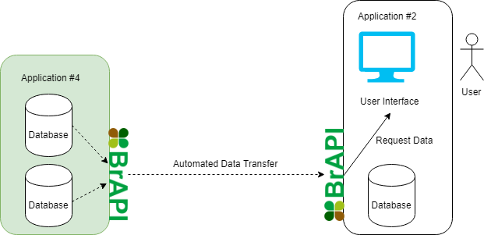
Automated Data Transfer

Slide 12
Who is in the BrAPI Community?

Slide 13
Who is in the BrAPI Community?
37+ registered partner organizations
250+ plant breeders, software developers, data managers, and other expert scientists
6 Elected members of the Advisory Board, managing the long-term goals of the project

Slide 14


Slide 15

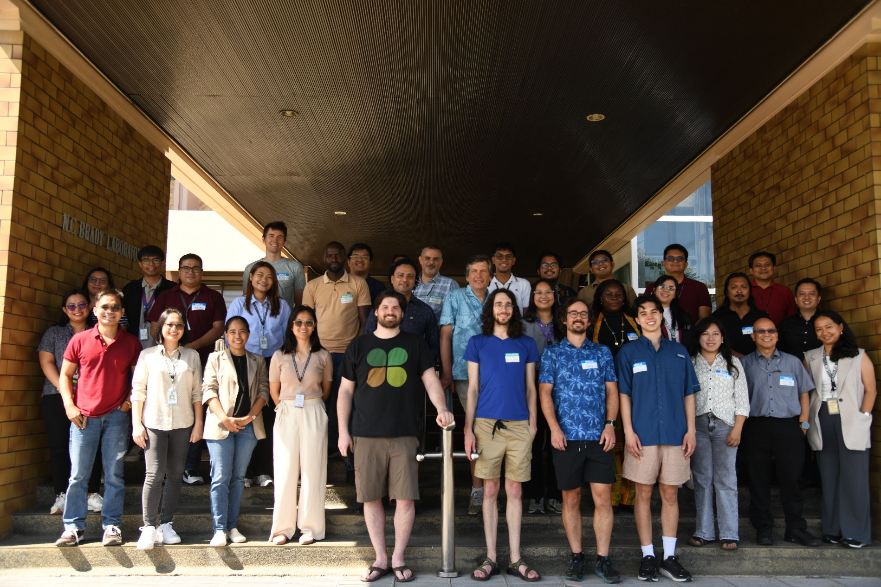






Wageningen, Netherlands - 2019
Los Baños, Philippines - 2025
Hyderabad, India - 2020
Versailles, France - 2018
Wittenberg, Germany - 2024
Texcoco, Mexico - 2018
Dundee, Scotland - 2019
Greenville, SC, USA - 2023
BrAPI Hackathons!!

Slide 16
How to contribute to the BrAPI Community
Join the mailing list
Join the Slack channel
Build a BrAPI compatible project
Register that project on brapi.org
Add your organization as a BrAPI partner
Attend a BrAPI Hackathon
Attend a BrAPI Sabbatical
Participate in a working group
Submit a change suggestion on GitHub
Contribute code to an open source BrAPP

Slide 17
Applications & Impacts

Slide 18
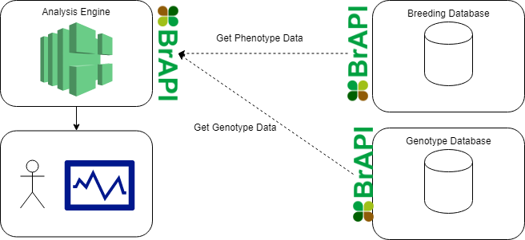
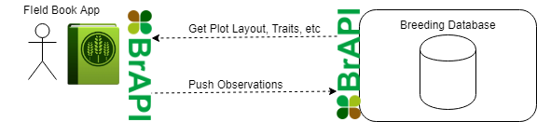
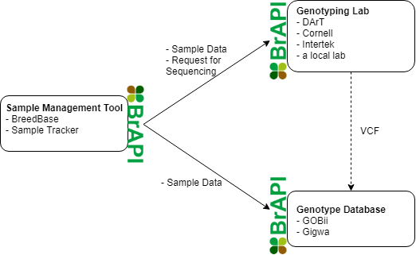
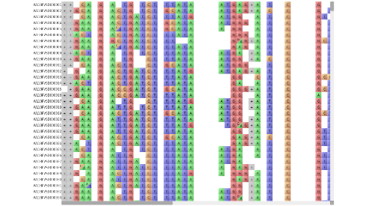

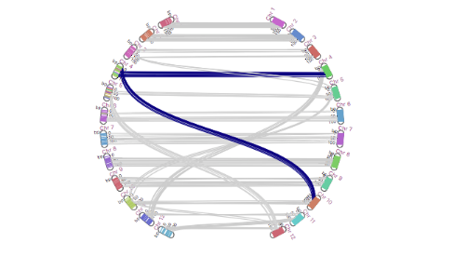
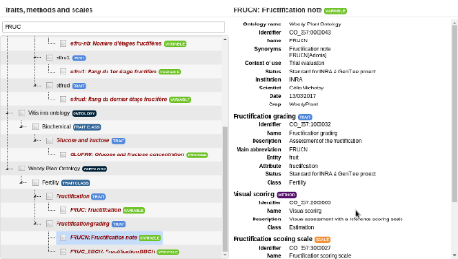
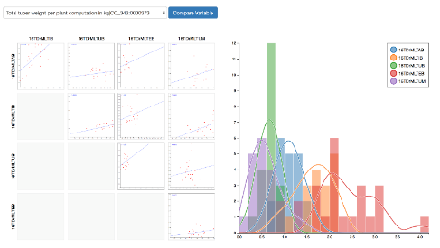
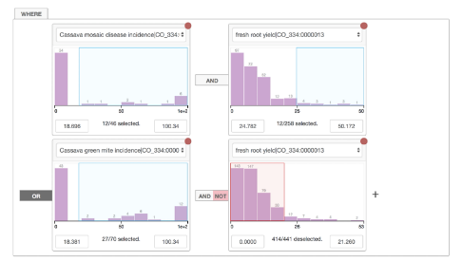
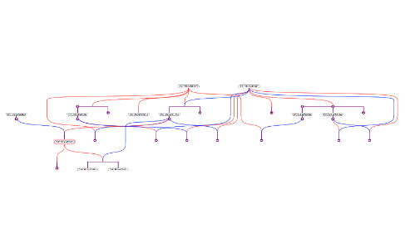
Solved Use Cases
BRAPPs

Slide 19
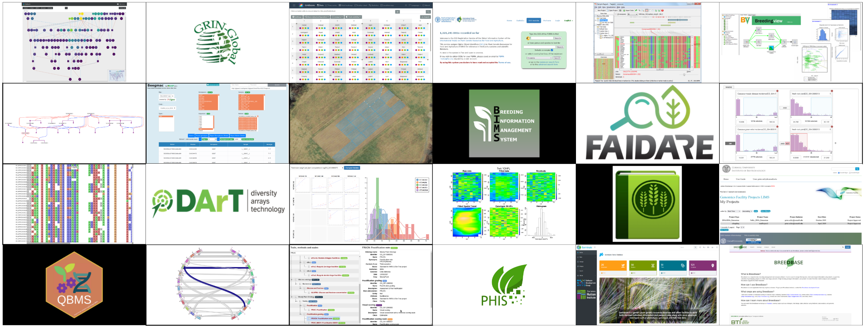
BrAPI Compatible Software

Slide 20
How does BrAPI work?

Slide 21

Typical Request/Response Loop
Client Application
Server Application
UI
Controller
Request Builder
HTTP Service
API Layer
Object Mapping Layer
Database Access Layer
Database
Response Handler
Notes:
In many cases, the most complex part of any BrAPI implementation is mapping proprietary application data to and from the BrAPI standard models. This diagram may look different for different programing languages, libraries, or frameworks, but the general recommendations are the same.
When implementing BrAPI in a client application, it is a good idea to add a request building layer and a response handling layer to the client code stack. The request builder is responsible for translating user actions into standard BrAPI service requests. The response handler is responsible for converting standard BrAPI data models into data structures the UI can interpret.
When implementing BrAPI in a server application, it is a good idea to add an object mapping layer to the server code stack. This layer is responsible for translating between the BrAPI standard models and the internal database models.
By adding these layers, applications can communicate using the standard models without contaminating existing, internal code.

Slide 22
URLs
GET, POST, PUT
https://<specific host path>/brapi/v2/<brapi standard endpoint>
Examples:
GET https://example.org/path/morepath/brapi/v2/studies/3d39af43
GET https://example.org/brapi/v2/studies?germplasmDbId=2d30af45&active=true
POST https://otherexample.org/path/morepath/brapi/v2/studies
PUT https://otherexample.org/brapi/v2/studies/7b3a6f48

Slide 23
Types of BrAPI Endpoints
Retrieve a Single Object by DbId or a Filtered List
GET https://example.org/brapi/v2/studies/3d39af43
GET https://example.org/brapi/v2/studies?germplasmDbId=2d30af45&active=true
Search with Complex Parameters
POST https://example.org/brapi/v2/search/studies {Search Request JSON}
GET https://example.org/brapi/v2/search/studies/5a00af65
Add New Objects
POST https://example.org/brapi/v2/studies {Entity List Request JSON}
Update Existing Object
PUT https://example.org/brapi/v2/studies/7b3a6f48 {Single Entity Request JSON}

Slide 24
Standard Request
Single Entity Request Generally used when updating a single entity using a PUT request
Entity List Request Used when creating multiple entities using a POST request. DbIds are not sent when creating new entities.
Search Request Used when using a complex search endpoint
Single Entity Request
{
“entityName": “Readable Name",
“entityDescription": “Description”,
“listOfDetails": [
"foo", "bar", "baz"
]
...
}
Entity List Request
[
{
“entityName": “Readable Name 1",
“entityDescription": “Desc 1”,
“listOfDetails": [
"foo", "bar", "baz"
]
...
},
{
“entityName": “Readable Name 2",
“entityDescription": “Desc 2”,
“listOfDetails": [
“boo", “far", “faz"
]
...
},
...
]
Search Request
{
“entityDbIds": [
"foo", "bar", "baz"
],
“relatedEntityDbIds": [
"for", "bao", “faz"
],
“dateRangeStart": “2020-01-01”,
“dateRangeEnd": “2020-12-12”,
...
}

Slide 25
Standard Response
Every BrAPI JSON response object has 2 keys
“metadata” key contains information about the call
“result” contains the business data requested by the caller
{
“metadata”: {
“pagination” : {}
...
},
“result”: {
“data”: []
...
}
}

Slide 26
Standard Response - Metadata
“pagination” When the data returned contains a large list, it is often necessary to paginate that list and only retrieve a subset (aka a page). The Pagination object contains meta information about the current paging status, and how many total records and pages are available.
“status” The status key contains an array of Status objects. This allows the server to provide human readable messages which explain what has happened during a particular request.
"metadata": {
"pagination" : {
"totalCount" : 1234,
"pageSize" : 200,
"totalPages" : 7,
"currentPage" : 2
},
"status" : [{
"code" : "Info",
"message" : “Request Received"
}, {
"code" : “Warning",
"message" : “Value ‘xyz’ ignored"
}, {
"code" : “Error",
"message" : “Bad Parameter Value"
},
]
} ...

Slide 27
Standard Response - Result
List Response
"metadata" : {
"pagination" : {
"page" : 1,
"pageSize" : 2,
"totalCount" : 4,
"totalPages" : 2,
...
},
"result" : {
"data" : [
{
“entityDbId": “Unique Identifier 1",
“entityName": “Readable Name 1",
“entityDescription": “Desc 1”,
“listOfDetails": ["foo", "bar", "baz" ]
...
},
{
“entityDbId": “Unique Identifier 2",
“entityName": “Readable Name 2",
“entityDescription": “Desc 2”,
“listOfDetails": [“boo", “far", “faz"]
...
}
]
}
Single Entity Response In this type of response, the "result" key consists of arbitrary properties , and no "data" key (pagination does not apply).
List Response In this type of response, the "result" element only contains the "data" key, which is an arbitrarily long array of objects of the same type. (pagination applies)
Single Entity Response
"metadata" : {
"pagination" : null
...
},
"result" : {
“entityDbId": “Unique Identifier",
“entityName": “Readable Name",
“entityDescription": “Description”,
“listOfDetails": [
"foo", "bar", "baz"
]
...
}

Slide 28
Resources
BrAPI Specification
https://brapi.org/specification
GitHub
https://github.com/plantbreeding/API
ReadTheDocs
https://plant-breeding-api.readthedocs.io/
Compatible Software List
https://brapi.org/compatibleSoftware
Publication
https://doi.org/10.1093/bioinformatics/btz190
Contact
https://brapi.org/contact

